Slide 1
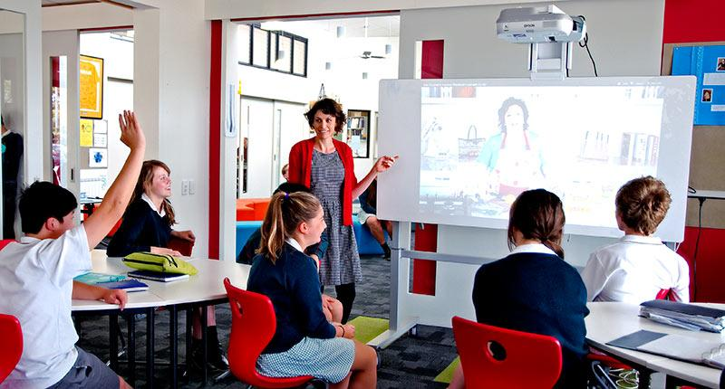

Assessment 2A - 2019 EDU2CAA
CURRICULUM AND ASSESSMENT
Notes:
IMPROVING STUDENT PERFORMANCE THROUGH BUILDING INSTRUCTIONAL CAPACITY-Elmore, Fullan et al
Chart paper, blu-tac and markers as needed.
Links to PAT videos
Print off the pages refer1red to slide 7 or use links as listed on the slide

Slide 2
Complete Part A Table
Compile and complete the table on the next slide
Realise the word count - “Complete the table in dot points or short sentences”
We are interested in seeing that you know the differences and that you are well positioned to “write an overview”.
Don’t stress too much about the word count – but don’t get carried away either. We want to see that you know the work

Slide 3
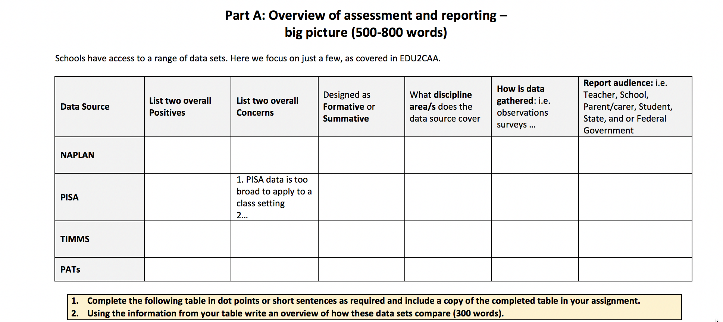
How do I interpret the Individual Report for PAT ... assessmentservices.nzcer.org.nz Introduction An Individual Report maps how well a student has performed on the different questions within a test. Although the Individual Reports for PAT:Mathematics, PAT:Reading Comprehension and PAT:Reading Vocabulary look different, they are all built around a set of common concepts.

Slide 4
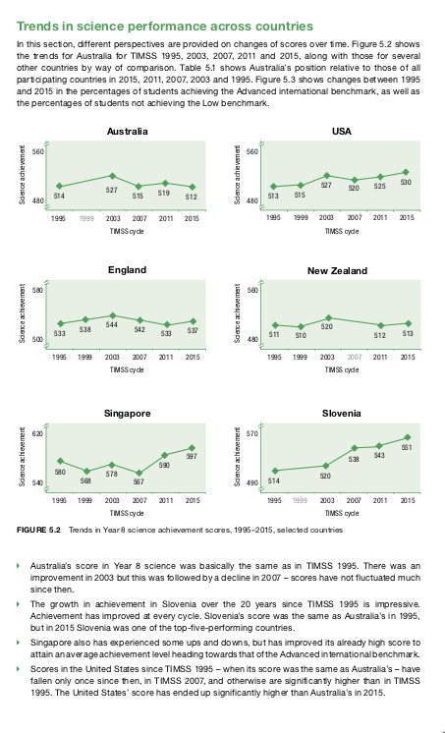
Using the information provided here from TIMMS (2015) Year 8 Science outcomes, write an account justifying why from a teacher’s perspective science education in Australian schools needs to be taken more seriously.
Note, it would be useful to substantiate your arguments with assessment data from other sources. (500 words)

Slide 5
Triangulate
Relate this back to the table you just created – this work is scaffolded so you are well prepared to use other sources - to triangulate your claims.
So: What other sources? You just listed some in the Table you created.

